Slide 1
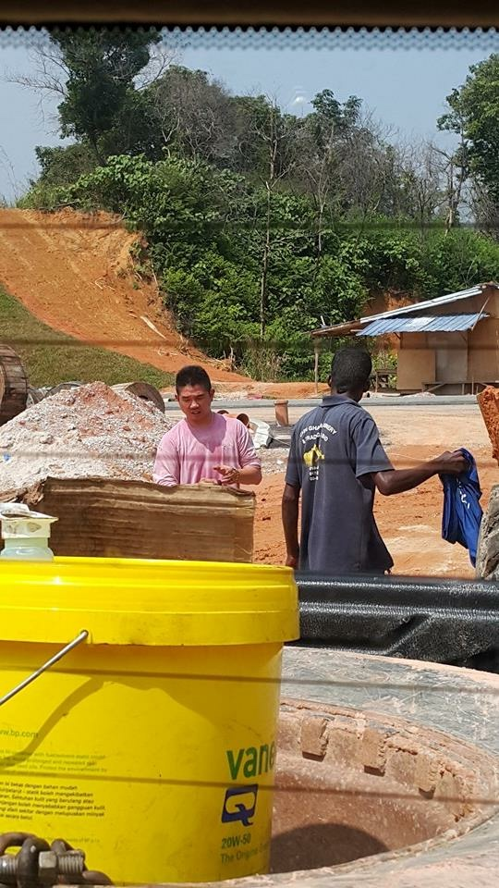
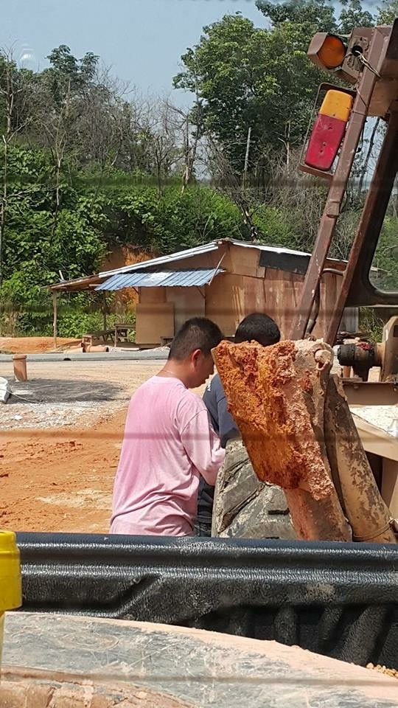
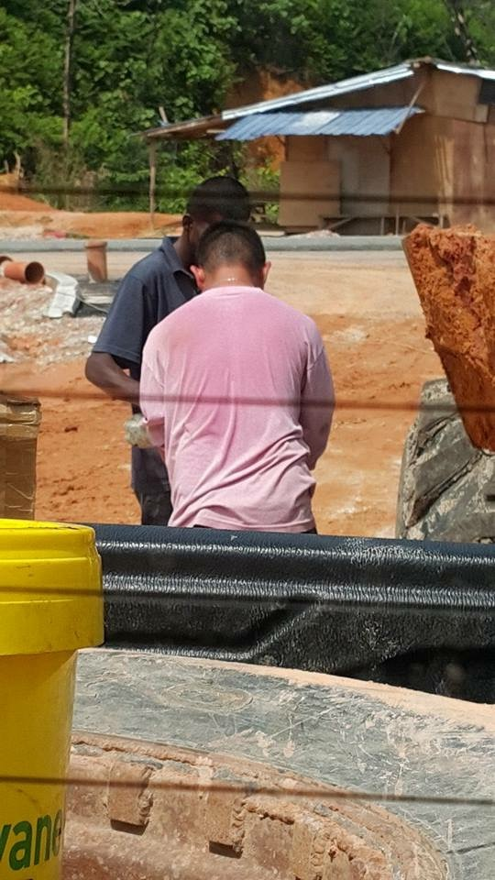
Life Before MA

Slide 2
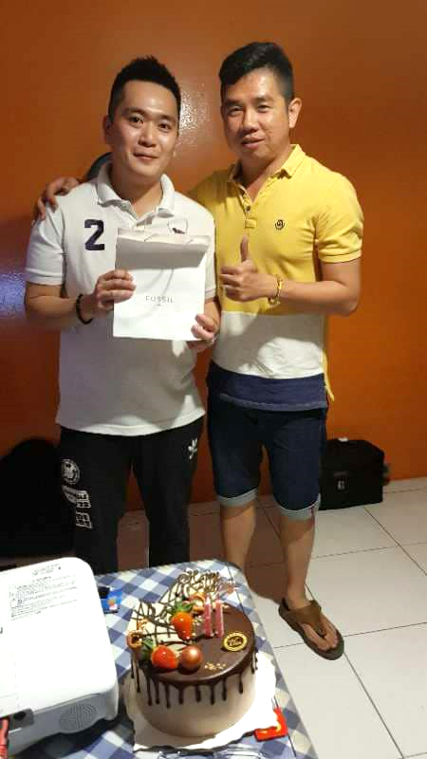
How did I learn about MA?
Weihao Yu - My Sponsor
Notes:
2015年在FACEBOOK认识一位网友，
他来自香港。
经常在FACEBOOK看见他的商机分享，在他不知情之下，我直接搭飞机前往香港，看看到底他做着什么样的生意？在香港美安上了我人生中第一堂的商机说明会。

Slide 3
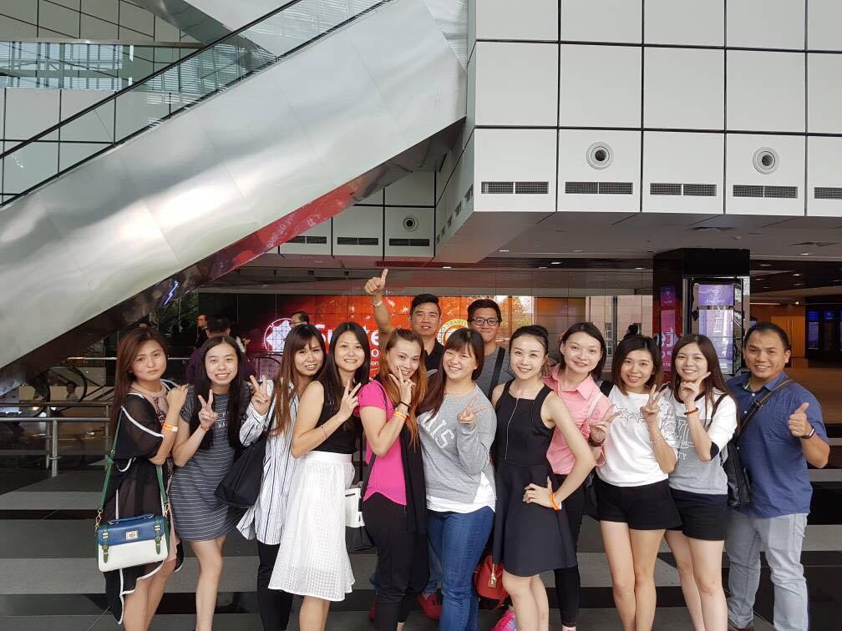
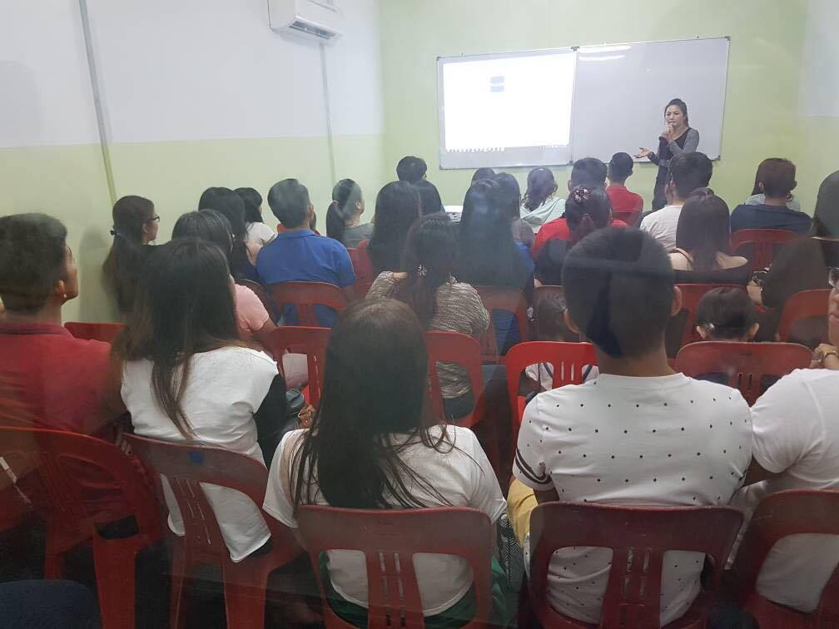
How I Started My MA Business
Invited 13 friends to attend
Market Singapore 2016 Annual Convention!
Started recruiting and introducing business opportunities to friends and family
Notes:
2016年参加新加坡年会，约了13位朋友一起参加！

Slide 4
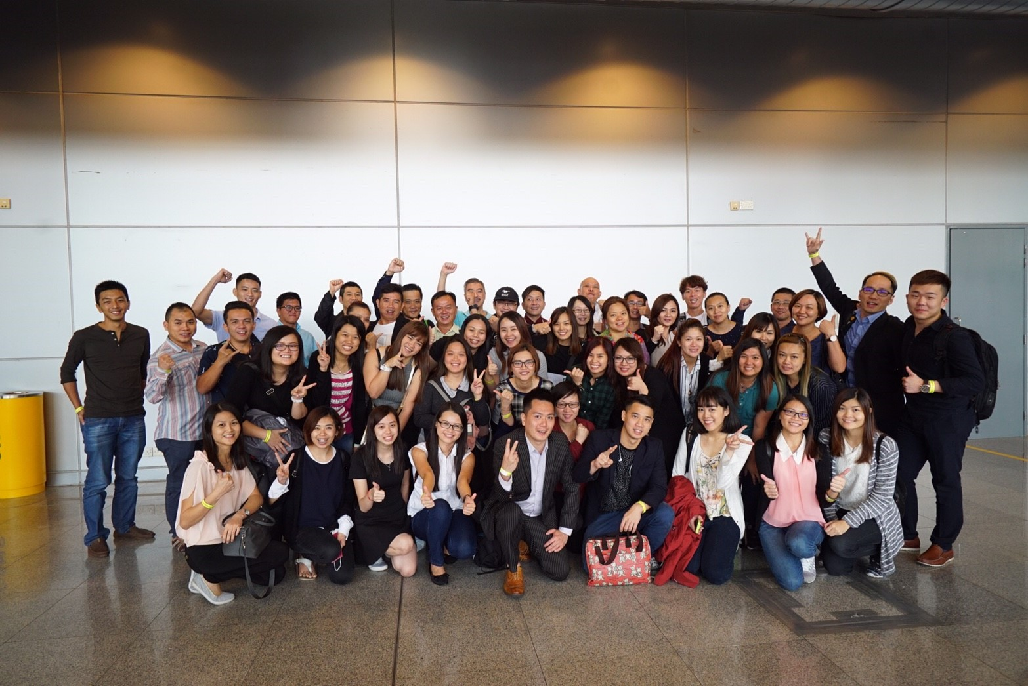
Invited 24 friends to attend
Market Singapore 2017 Annual Convention
BELIEVE
Notes:
2017年参加第二次的新加坡年会，这次约了24位朋友出席
多次被人家拒绝，多次被人数落，但凭着相信的决念，告诉自己永不放弃，必须走到终点，一定会有成功的一天。

Slide 5
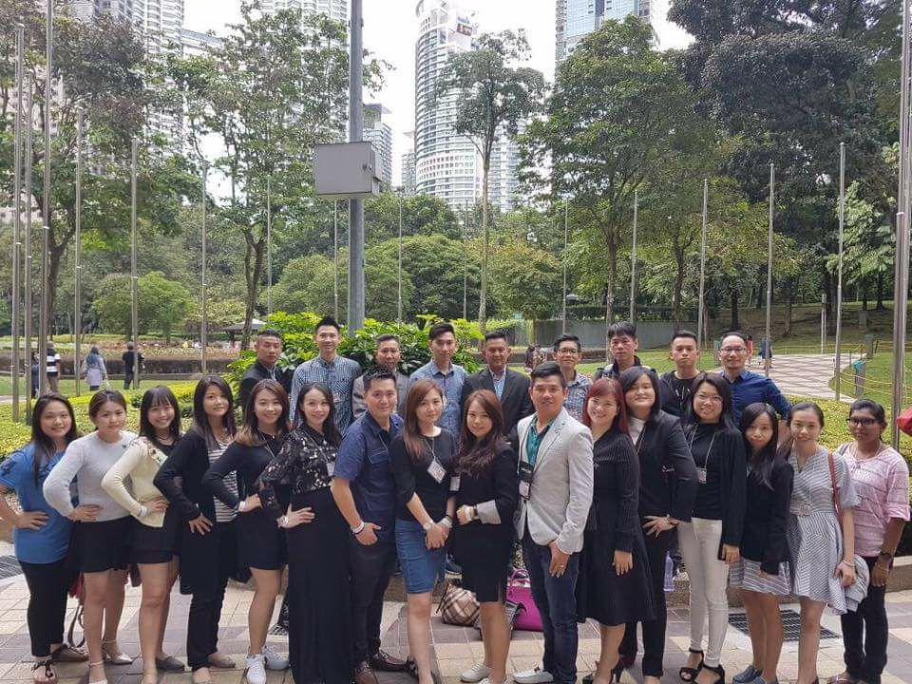
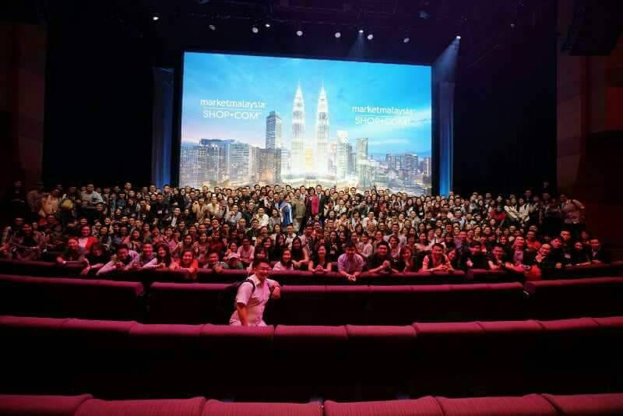
Market Malaysia Opening Ceremony 2017, a long-awaited historical moment

Slide 6
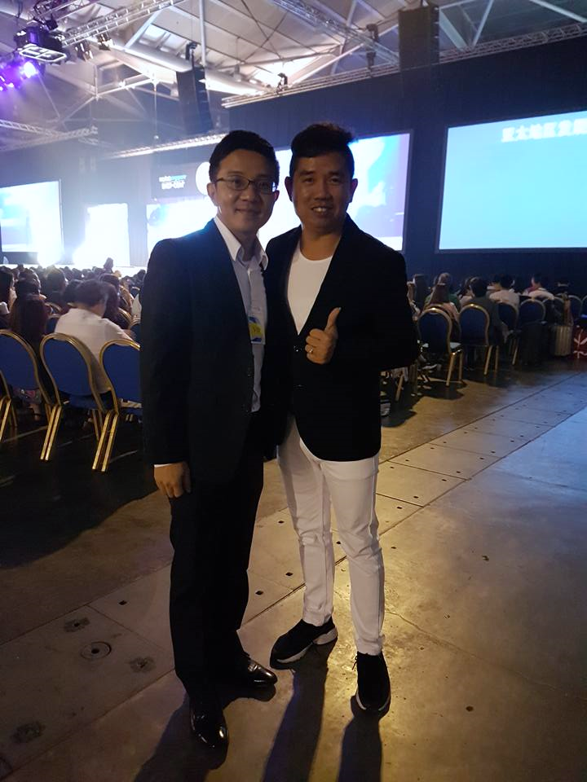
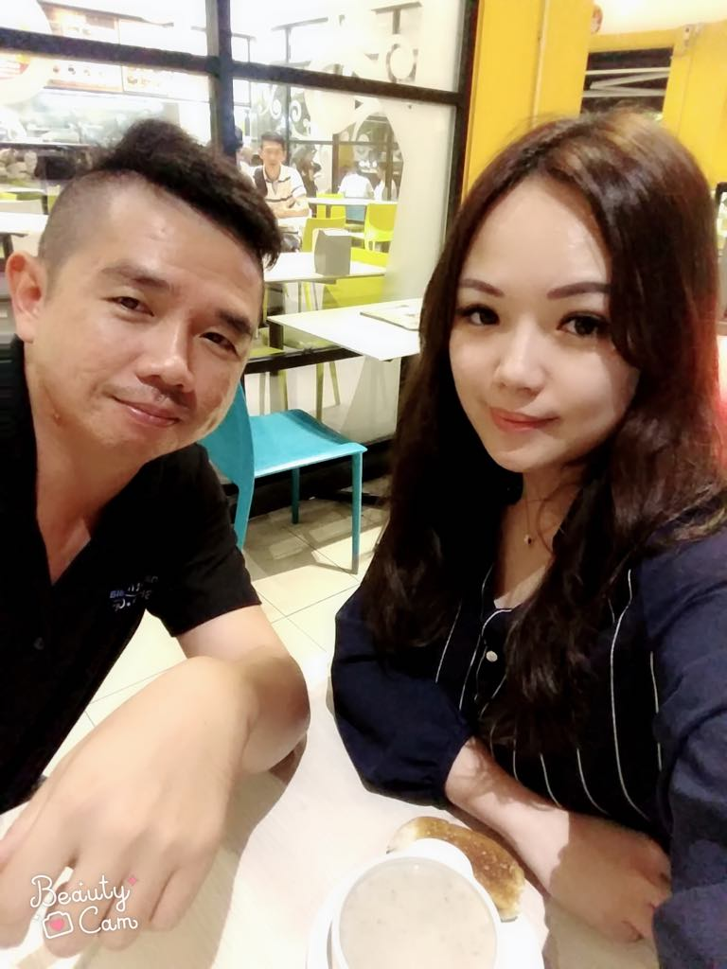
All the great people in my life told me the importance of “buying & selling tickets”.
I didn’t quite understand in the beginning. But I decided to follow suit.
Johnny Huang
Huiyin Yang
Weihao Yu
Tianling Chen
Notes:
一路相助的贵人，是他们告诉我买票卖票的重要性，一开始我不明白，但我选择听话照做。

Slide 7
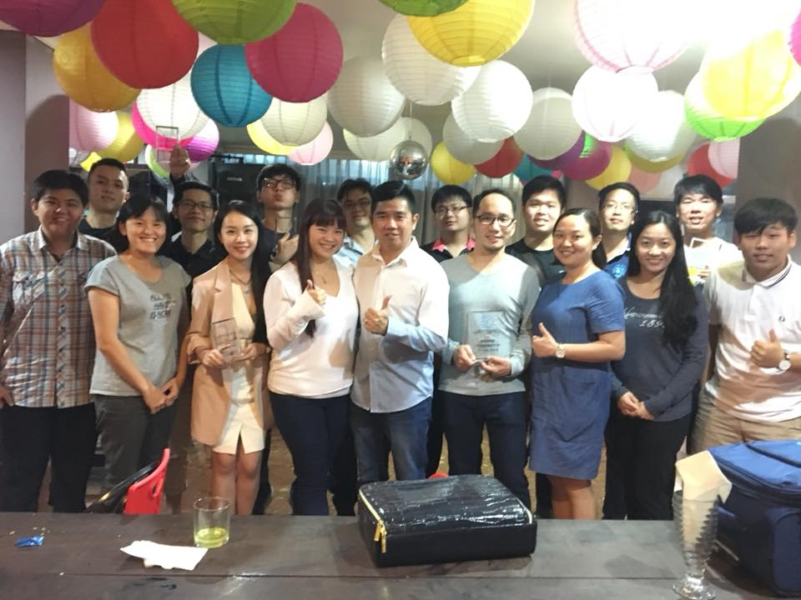
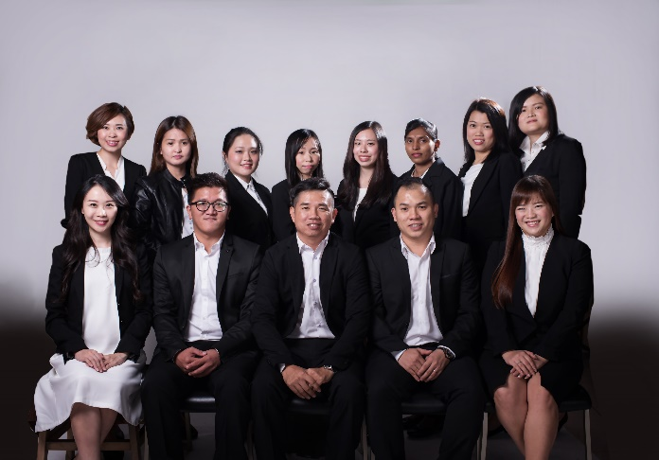
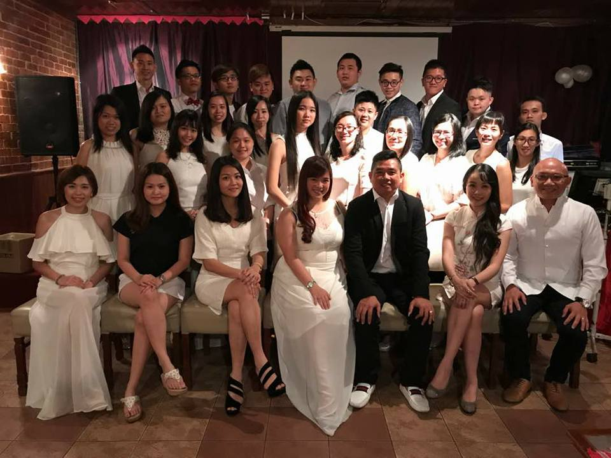
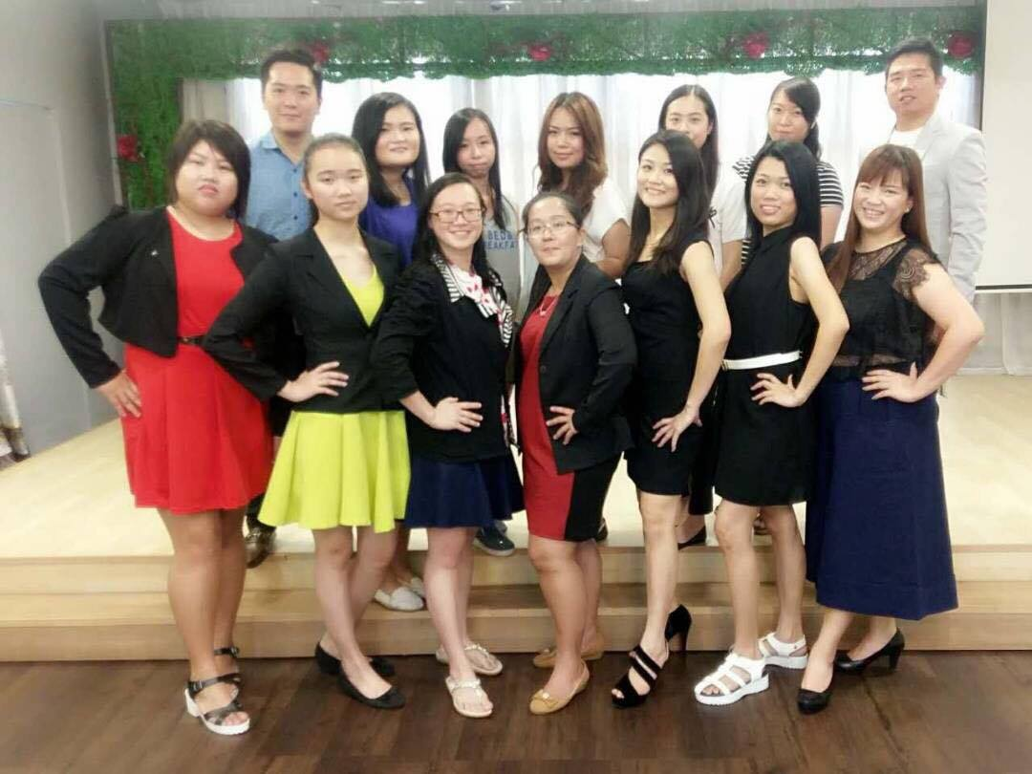
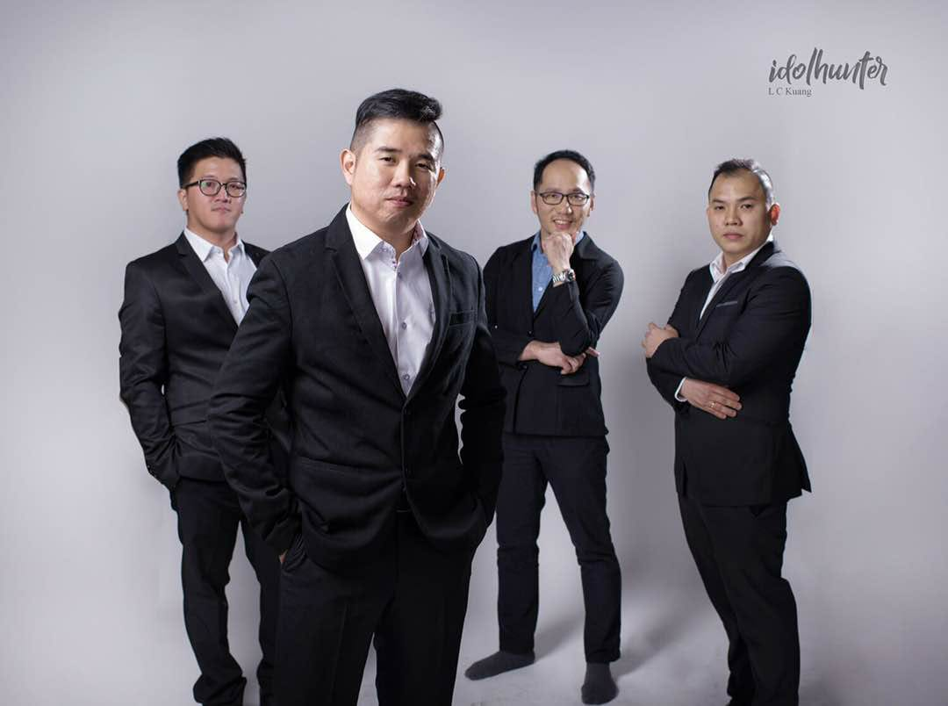
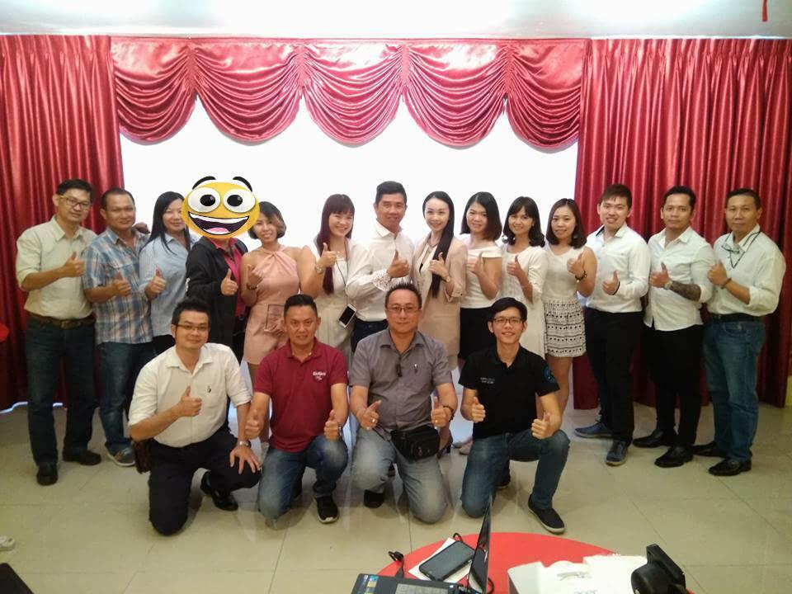
My Partners

Slide 8
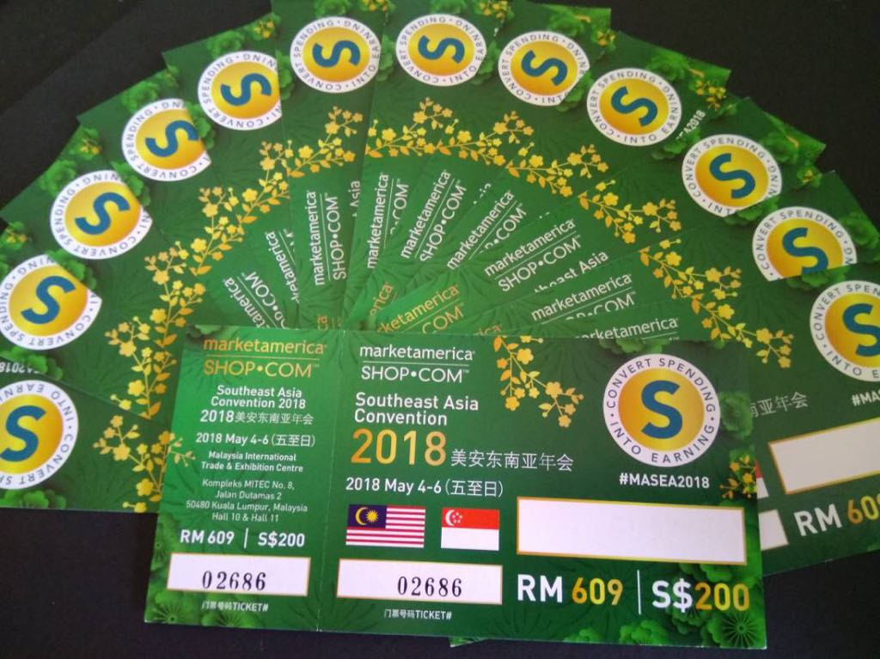
A Chance For Yourself, Change Your Life

Slide 9
Successful People
Do what others do not want to do
Do what others dare not do
Do what others can't do
Persist, not because we see hope
Persist because it gives us hope

